Slide 1
Smart Scan for Healthy Vegetables
Group-7
1

Slide 2
GROUP MEMBERS
KPTMYK-001298 Mg Min Han Set Naing
KPTMYK-001285 Ma May Thiri Paing
KPTMYK-001286 Ma Wa Thone Thazin
KPTMYK-001288 Ma Pann Cherry Myo
KPTMYK-001330 Ma Thin Nandar Hsu
2

Slide 3
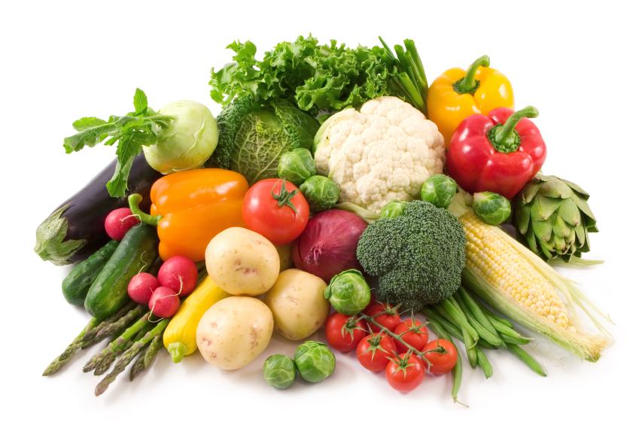
CONTENTS
Introduction
Objectives
System Flow Diagram
System Requirement
Implementation
Advantages
Limitation
Conclusion
Future Works
Reference
3

Slide 4
INTRODUCTION
Developed using Computer Vision technology
Automatically identifies vegetables using a camera
Analyzes the shape of vegetables
Accurately displays the vegetable type
Helps people easily recognize different vegetables
4

Slide 5
OBJECTIVES
To design a vegetable image acquisition system using a camera .
To preprocess captured images ( resize, color correction) for accurate analysis.
To extract important features such as color, texture, and shape from vegetable images.
5

Slide 6
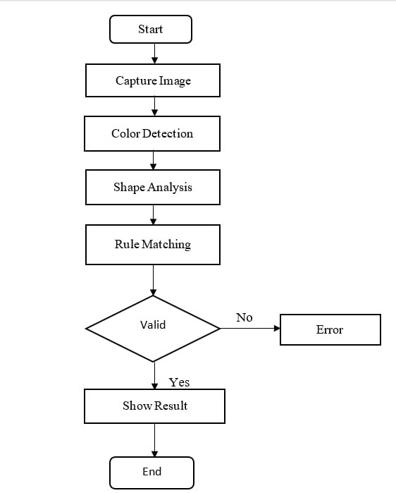
SYSTEM FLOW DIAGRAM
6

Slide 7
SYSTEM REQUIREMENT
Software requirements
Hardware requirements
OpenCV Library
NumPy
Camera scans vegetables in real-time, identifies their type, and shows their nutritional benefits.
7

Slide 8
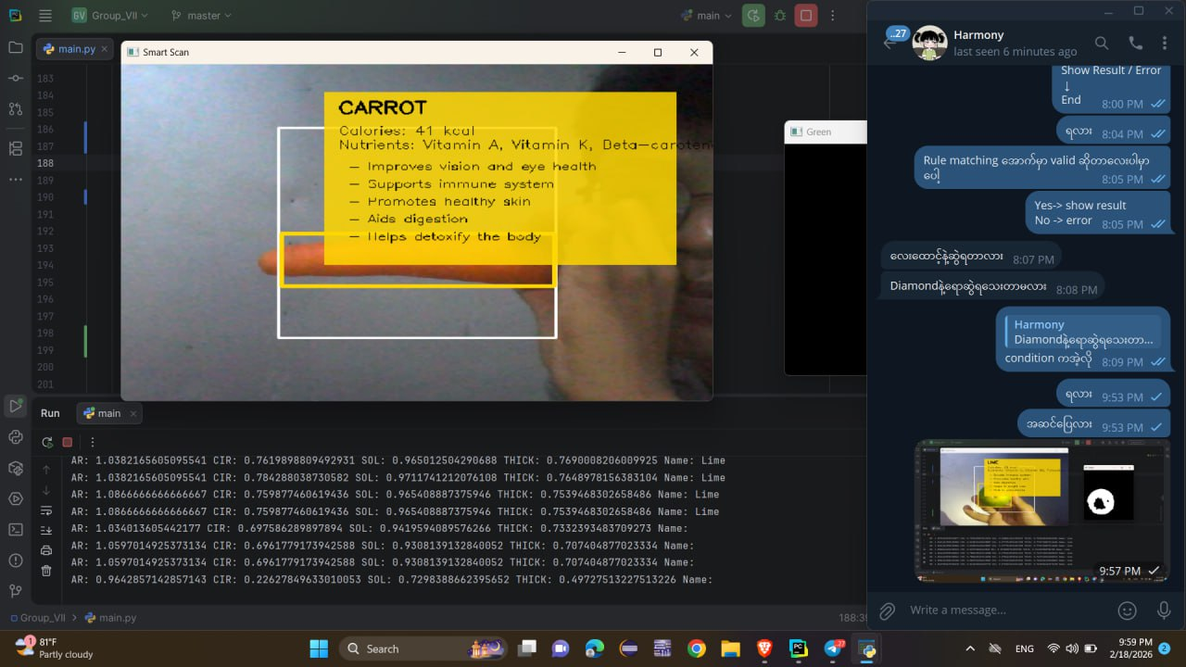
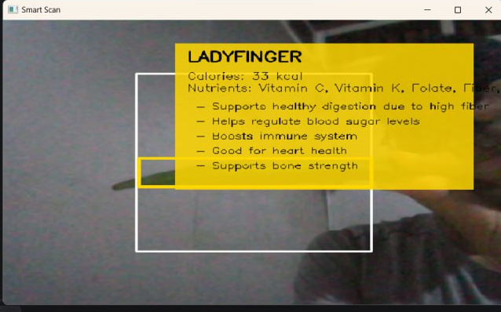
IMPLEMENTATION
When the user shows a vegetable, the system identifies the type of vegetables and displays its corresponding health benefits.
8

Slide 9
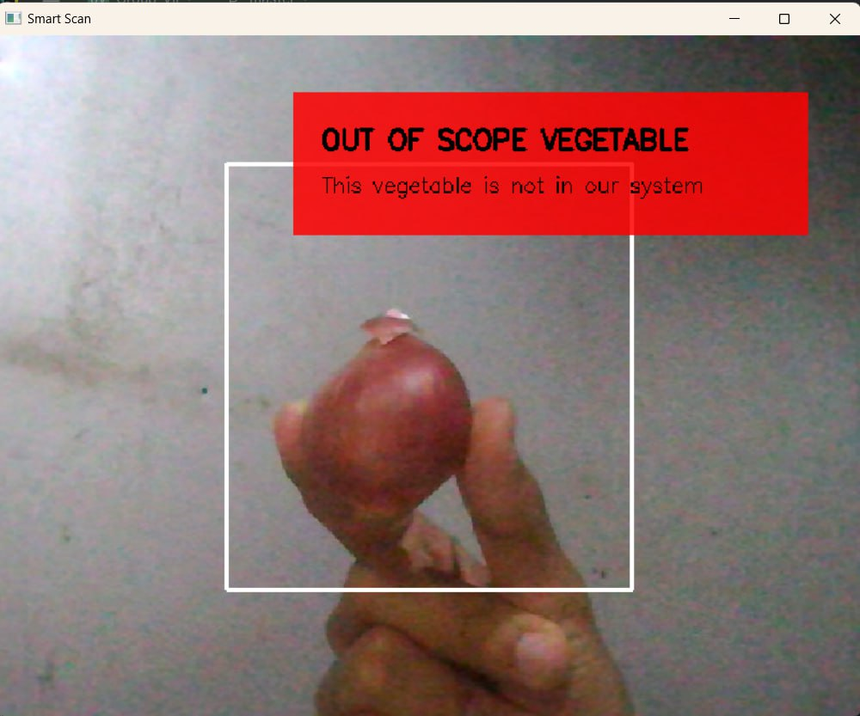
CONT’D
When the user shows a vegetable that is not included in the predefined vegetable list, the system displays an error message indicating that it cannot be recognized.
9

Slide 10
ADVANTAGES
Time-Saving
User-Friendly
Supports Healthy Eating
Scalable
10

Slide 11

LIMITATION
Poor lighting conditions can reduce accuracy.
Vegetables with similar shapes or colors may be misclassified.
Lack of a high-quality dataset can decrease system performance.
The system cannot detect internal spoilage (only external appearance).
Low hardware performance can slow down processing speed.
11

Slide 12
CONCLUSION
Accurately identifies vegetables using technology.
Saves time and reduces human error.
Provides nutrition and health information.
Supports healthy vegetables choices.
Helps people make better vegetables choices.
Teaches children about different vegetables and encourages healthy eating.
Supports health-conscious individuals in selecting nutritious vegetables.
12

Slide 13
FUTURE WORKS
The system currently detects vegetables using only shape features.
In the future, color and size features can be added.
More types of vegetables can be included in the system.
The system can be improved to work in real-time using a camera.
The overall accuracy of the system can be further enhanced.
13

Slide 14
REFERENCE
https://nutritionsource.hsph.harvard.edu/what-should-you-eat/vegetables-and-fruits/
https://www.python.org/
https://www.vegetables.co.nz/vegetable-a-z/vegetables-a-z
14

Slide 15
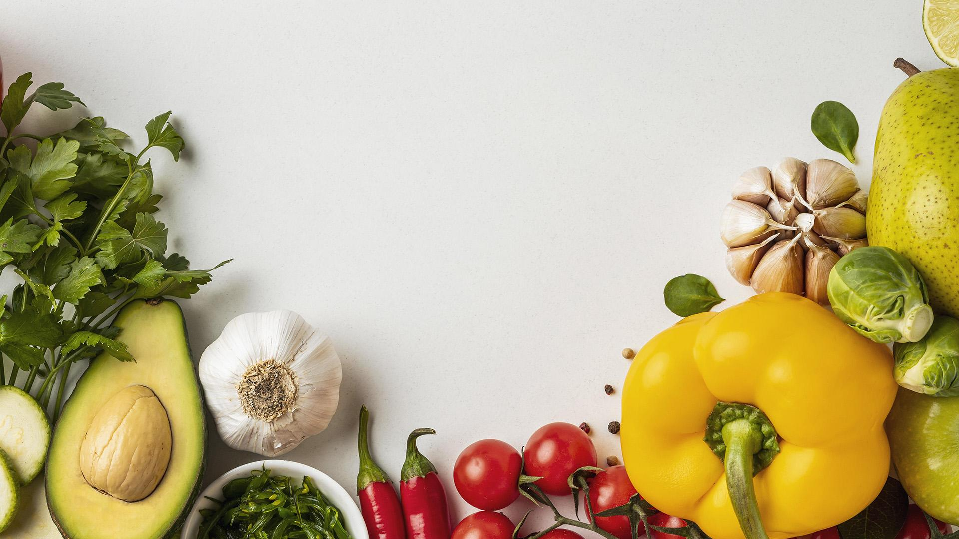
THANKS! HAVE ANY QUESTION?
15

